Slide 1

Flipkart Products Analysis
E-Commerce Industry
- Pratyush Majumdar

Slide 2
Objective
To analyze product data from Flipkart, identify key trends, and provide
actionable insights that can help in optimizing inventory management, improving pricing strategies, enhancing customer satisfaction, and driving sales growth.
The analysis will focus on understanding product performance, customer
preferences, pricing patterns, and competitive positioning, with the aim of supporting data-driven decision-making for e-commerce strategies.

Slide 3
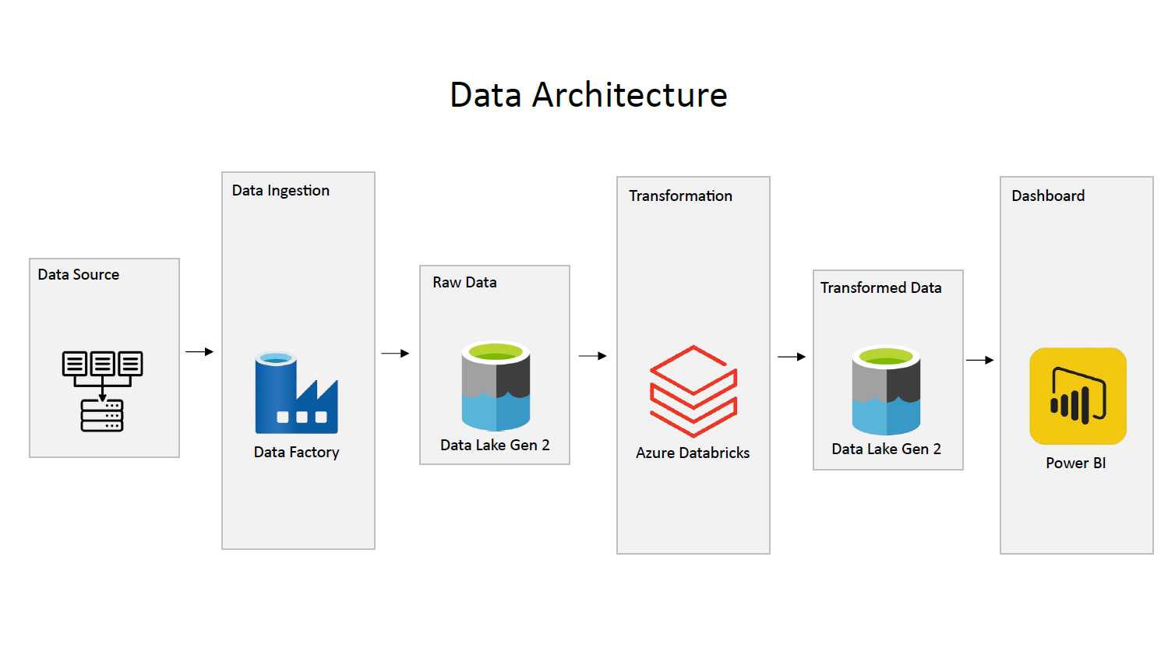
Data Architecture

Slide 4
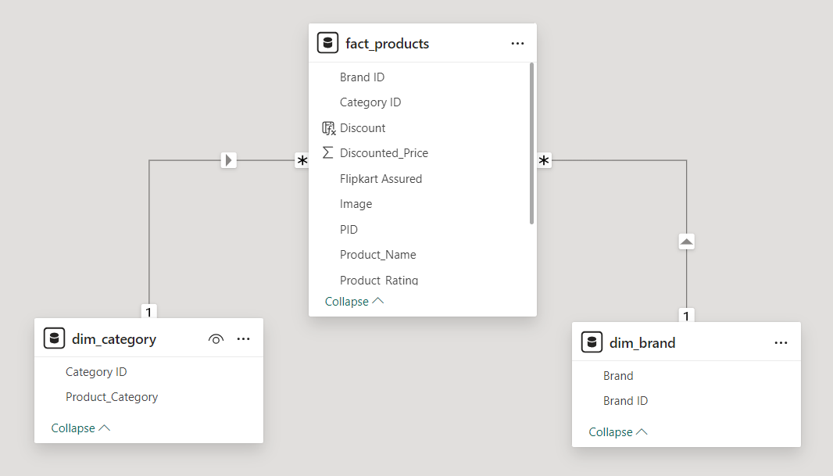

Data Model and Technology Used

Slide 5
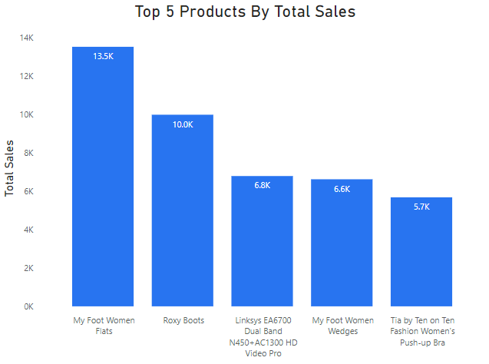
Insights
1) List down the top 5 products with the highest sales having flipkart assured.

Slide 6
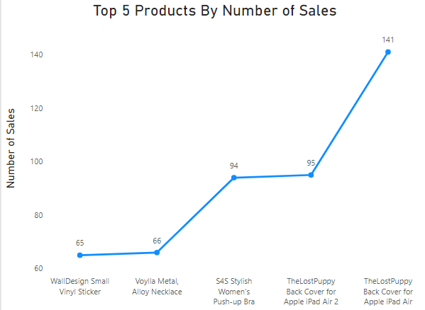
2) List down the top 5 products with the highest number of sales.

Slide 7
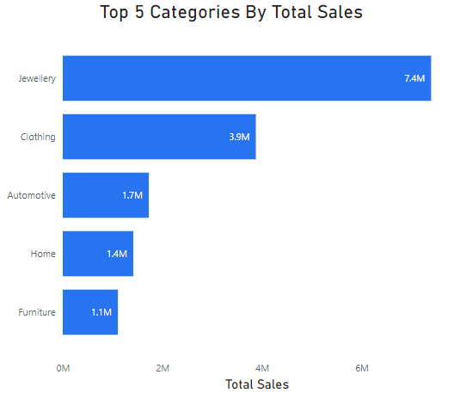
3) List down the top 5 categories with the highest sales not having flipkart assured.

Slide 8
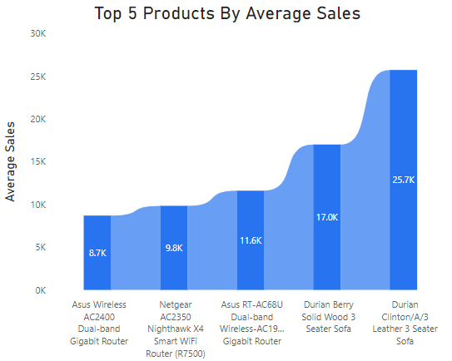
4) List down the top 5 products with the highest average sales having product rating greater than 4.

Slide 9
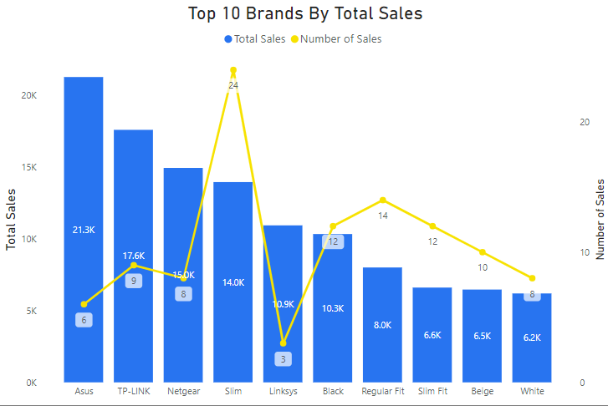
5) List down the top 10 brands with the highest sales having flipkart assured and also show the number of sales.

Slide 10
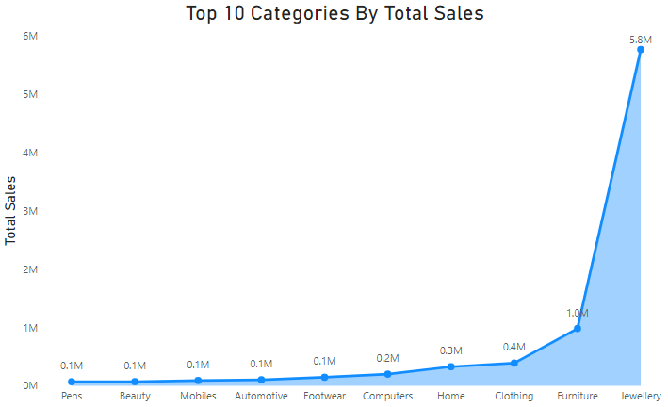
6) List down the top 10 categories with the highest sales having discount greater than 60%.

Slide 11
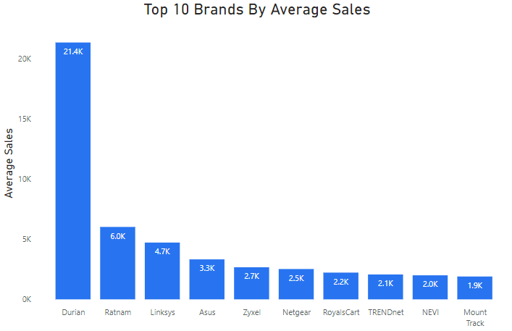
7) List down the top 10 brands with the highest average sales having discount greater than 50% and product rating greater than 3.

Slide 12
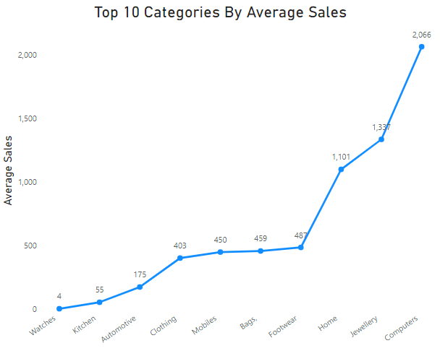
8) List down the top 10 categories with the highest average sales having product rating greater than 4 and having flipkart assured.

Slide 13
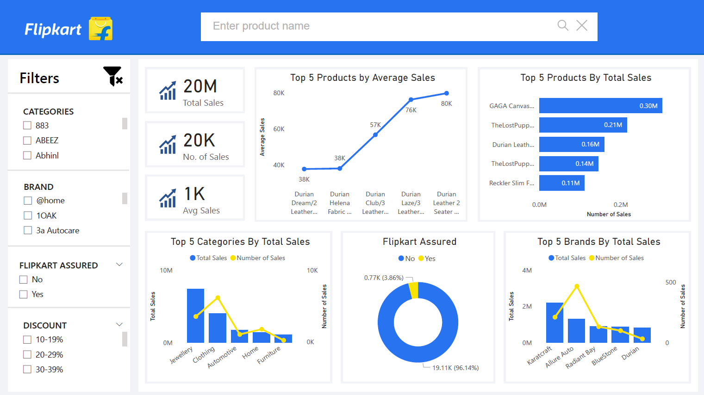
Dashboard

Slide 14

THANK YOU!
If its trendy, its on Flipkart.

